Slide 1
Storing and Retrieving Data Project Prof: Dr Ioannis T Christou
Kalmanidis Theodoros ID:218580
Winter Term 2020

Slide 2
Agenda
The dataset
Technological Stack
Databases & Spark Framework
Queries
Statistical Analysis

Slide 3
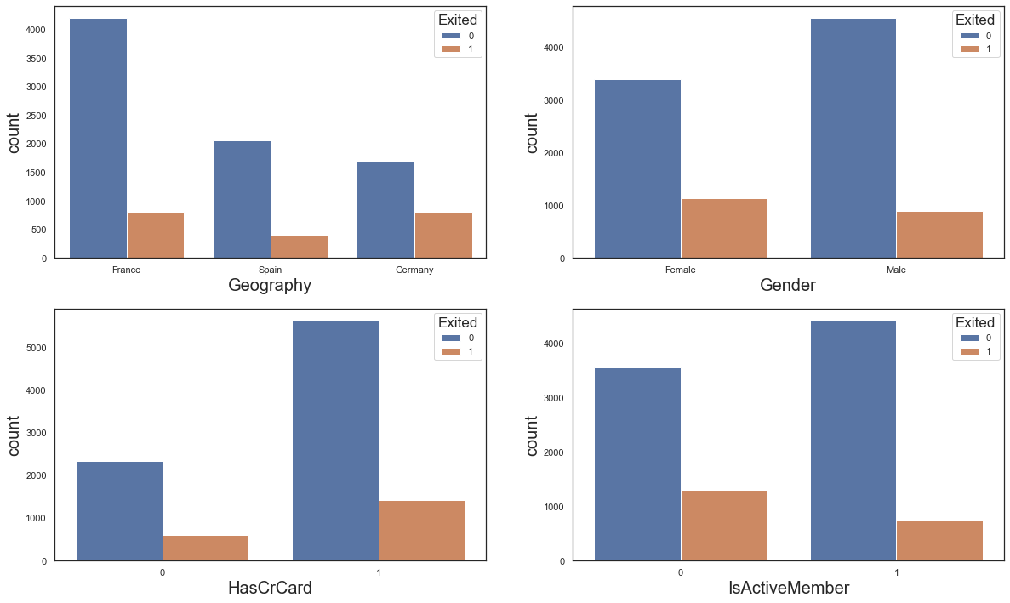
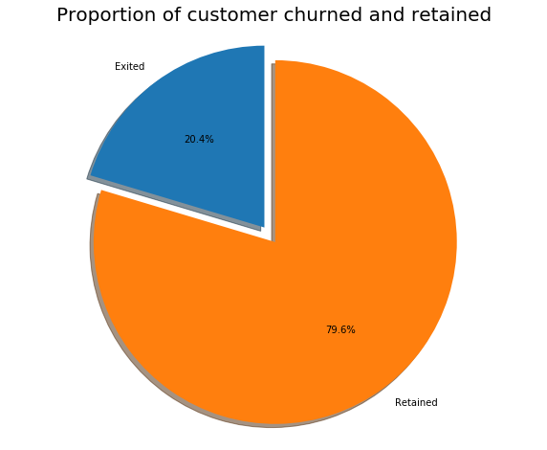
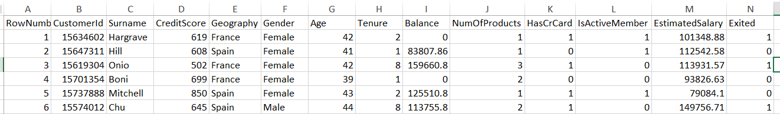
The dataset
The dataset is about Churn Modeling and it contains 10000 rows and 15 attributes; 3 of them have at least 10 distinct values

Slide 4


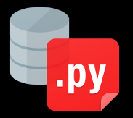







Technological Stack
Libraries
Pyodbc
Cx_Oracle
Psycopg2
MySql Connector
Pypsark
SQL Server 2012
Oracle 11 G2
Postgresql 10.12
MySQL 8
Apache Spark Framework
Notes:
Sources:
https://towardsdatascience.com/python-and-postgresql-how-to-access-a-postgresql-database-like-a-data-scientist-b5a9c5a0ea43
https://www.youtube.com/watch?v=pSfBRsTQ-n8
http://www.mysqltutorial.org/wp-content/uploads/2014/10/
https://oracle.github.io/python-cx_Oracle/
https://en.wikipedia.org/wiki/MySQL
https://www.oracle.com/database/
https://www.postgresql.org/
https://en.wikipedia.org/wiki/Apache_Spark
https://seeklogo.com/vector-logo/298266/microsoft-sql-server

Slide 5
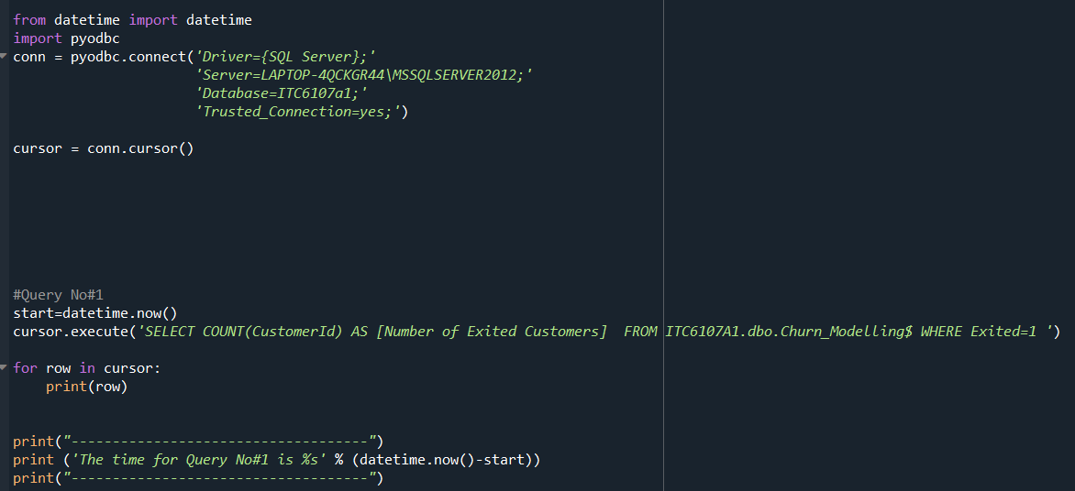
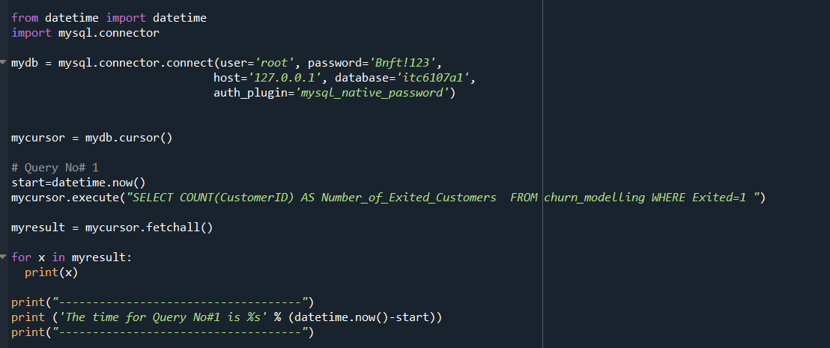
Databases & Spark Framework
Databases & Spark Framework

Slide 6
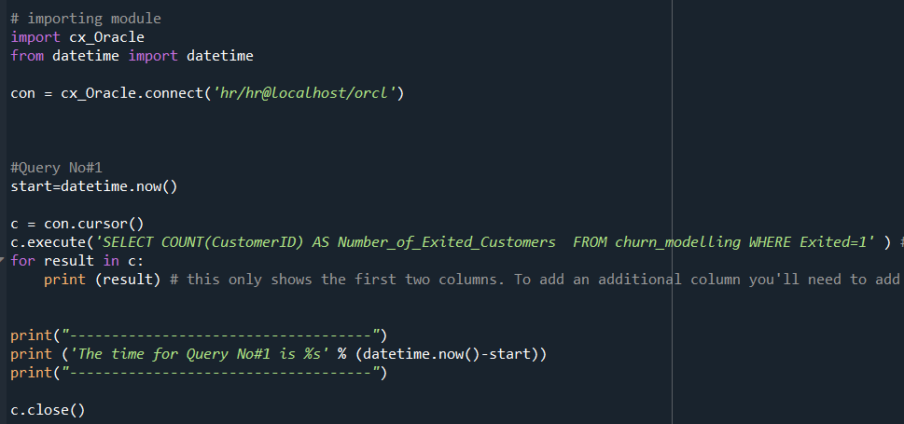
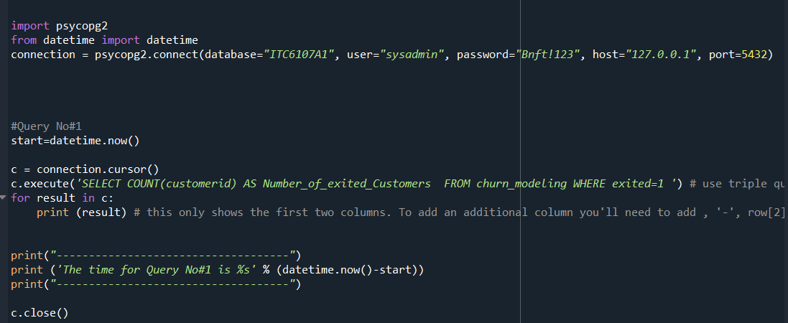
Databases & Spark Framework
Databases & Spark Framework

Slide 7
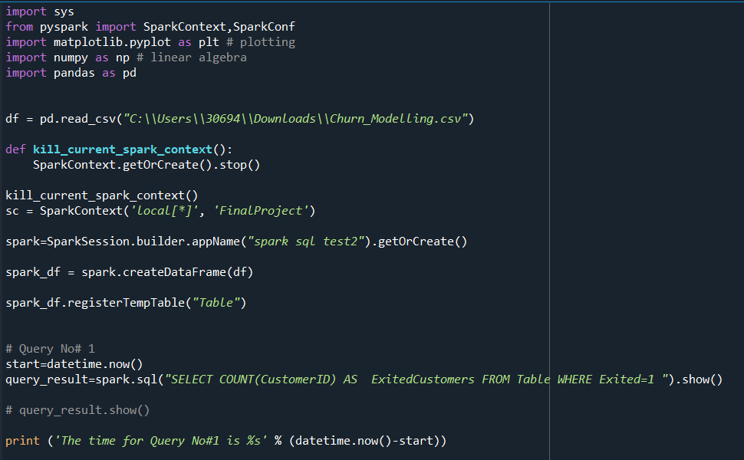
Databases & Spark Framework

Slide 8
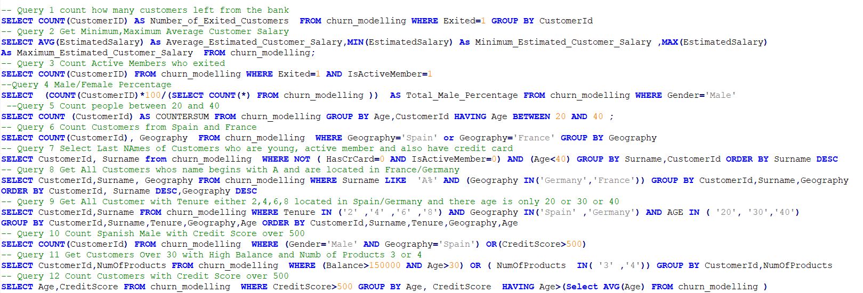
Queries

Slide 9
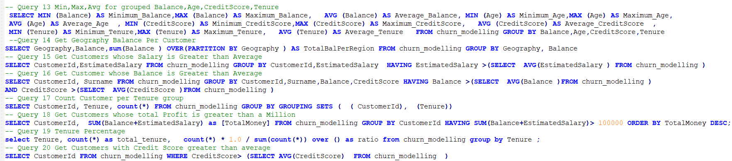
Queries

Slide 10
Statistical Analysis

Slide 11
Statistical Analysis

Slide 12
Thank you! Questions?

